Slide 1
Team 2 Games Storyboard
Kris Hayes, Michael Weaver, Aaron Fonseca, Brian Castro
CST-117
1/15/17
Dr. Chicone

Slide 2
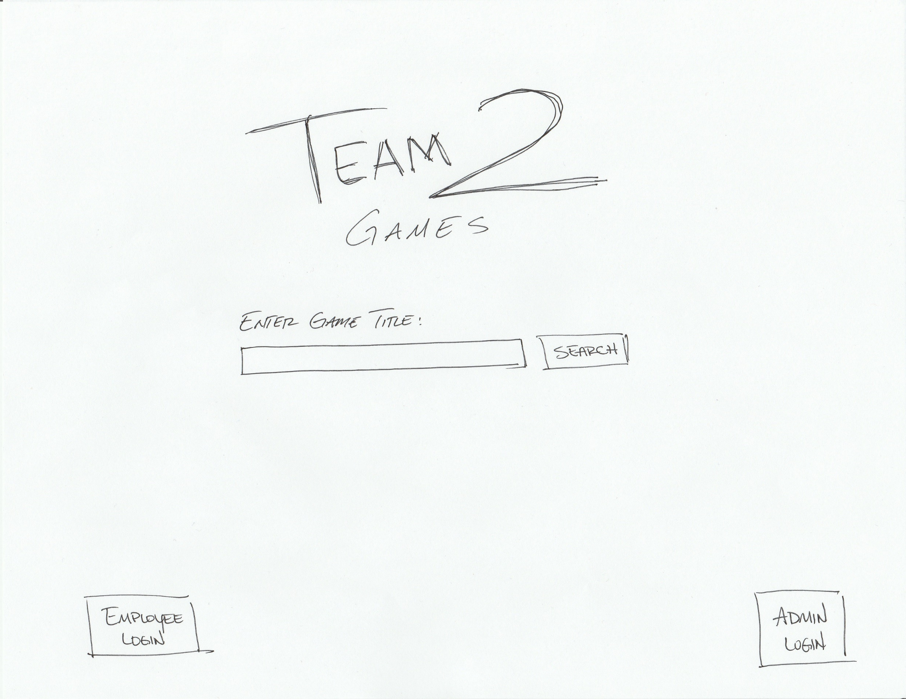
Opening Screen
Notes:
Main screen for customer use
Setup to allow for touch screen feature
Customer can search for game titles

Slide 3
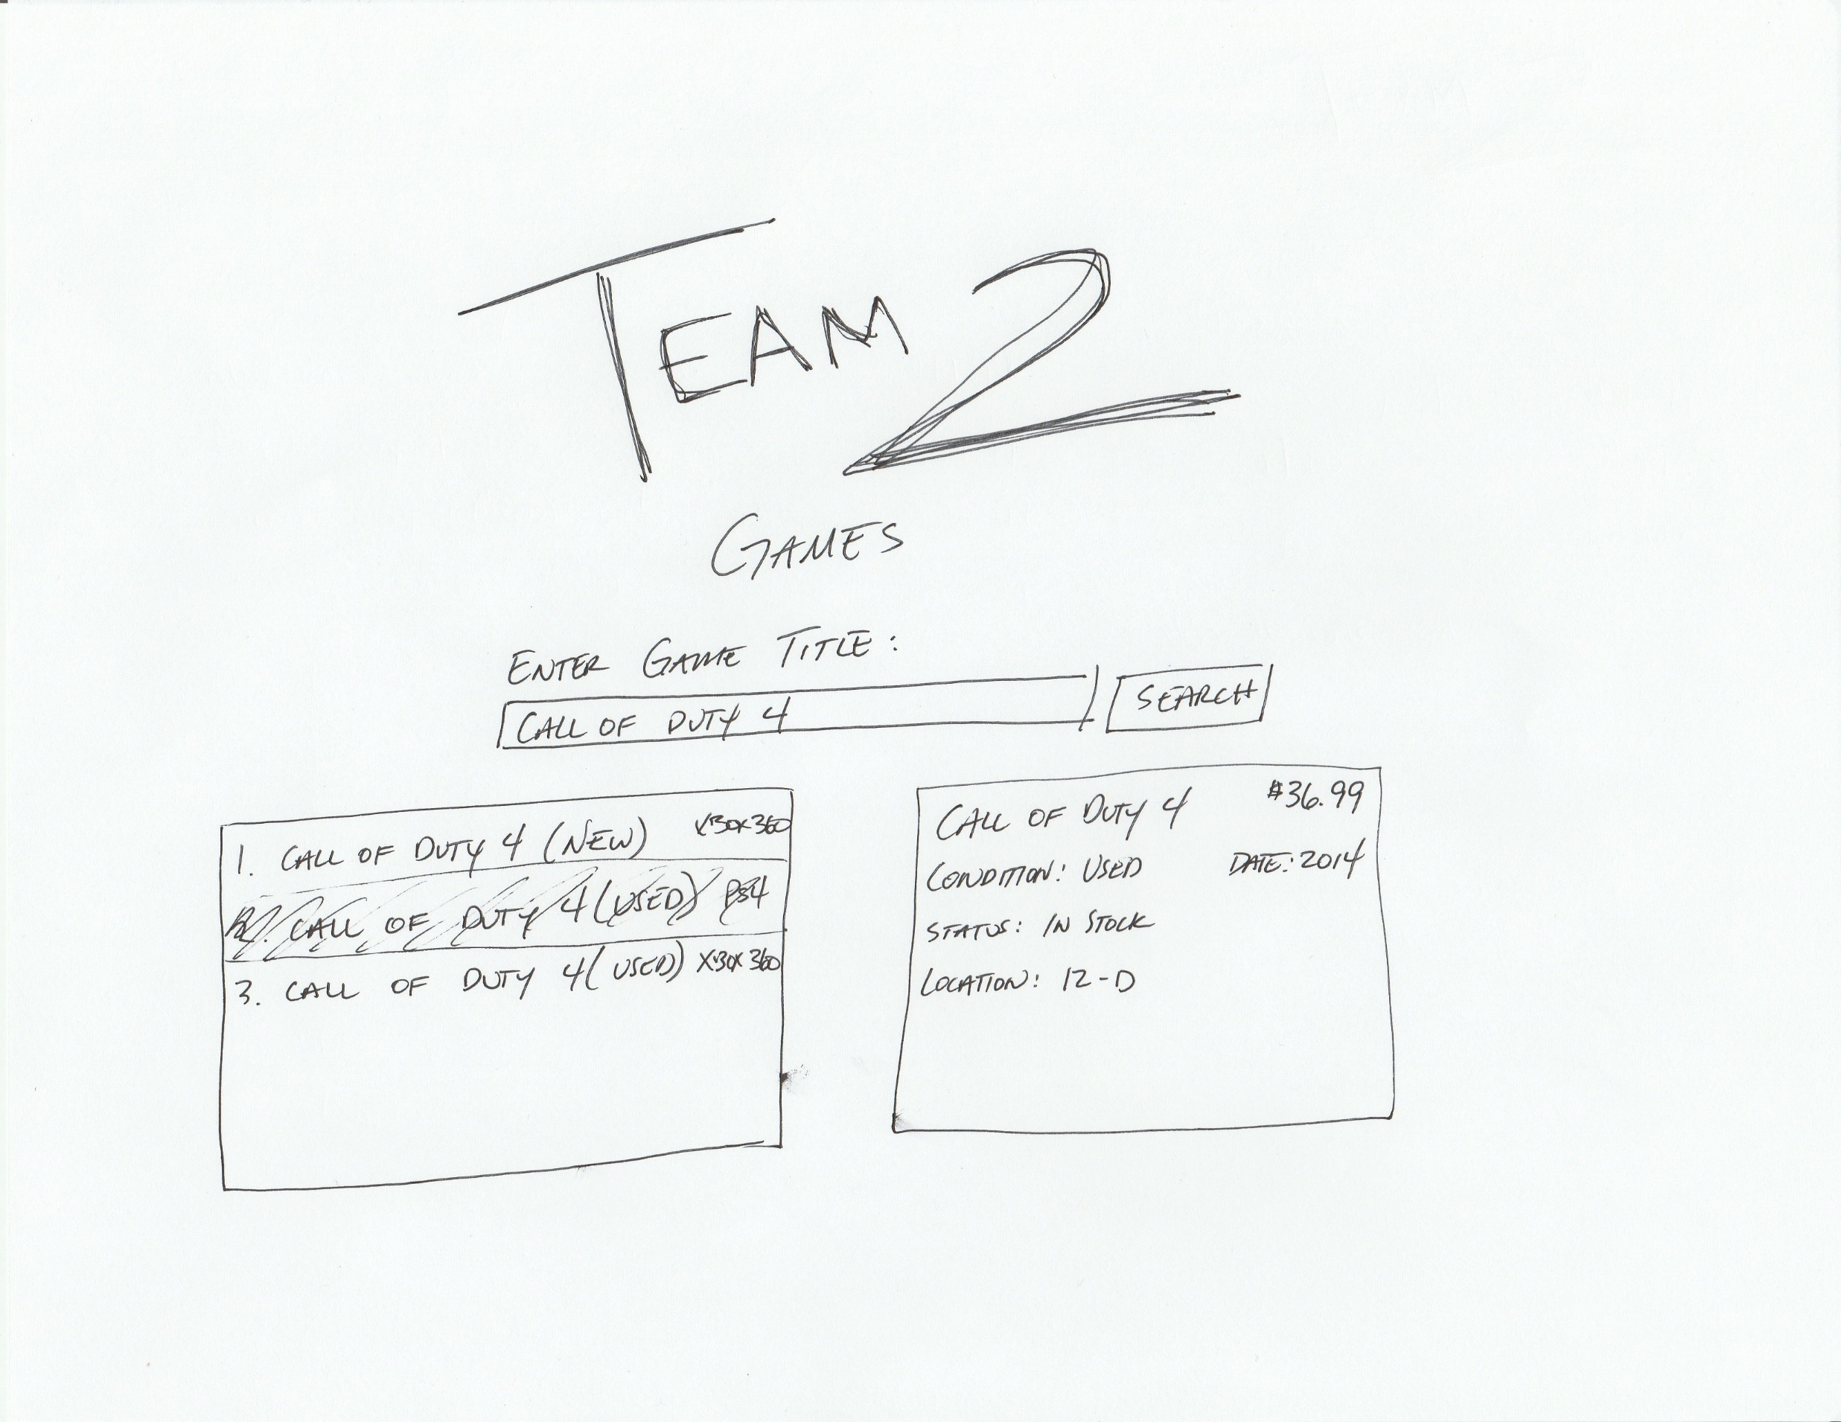
Customer Search
Notes:
Searched games will populate on the left side
Highlighting a game will show more details in the right window

Slide 4
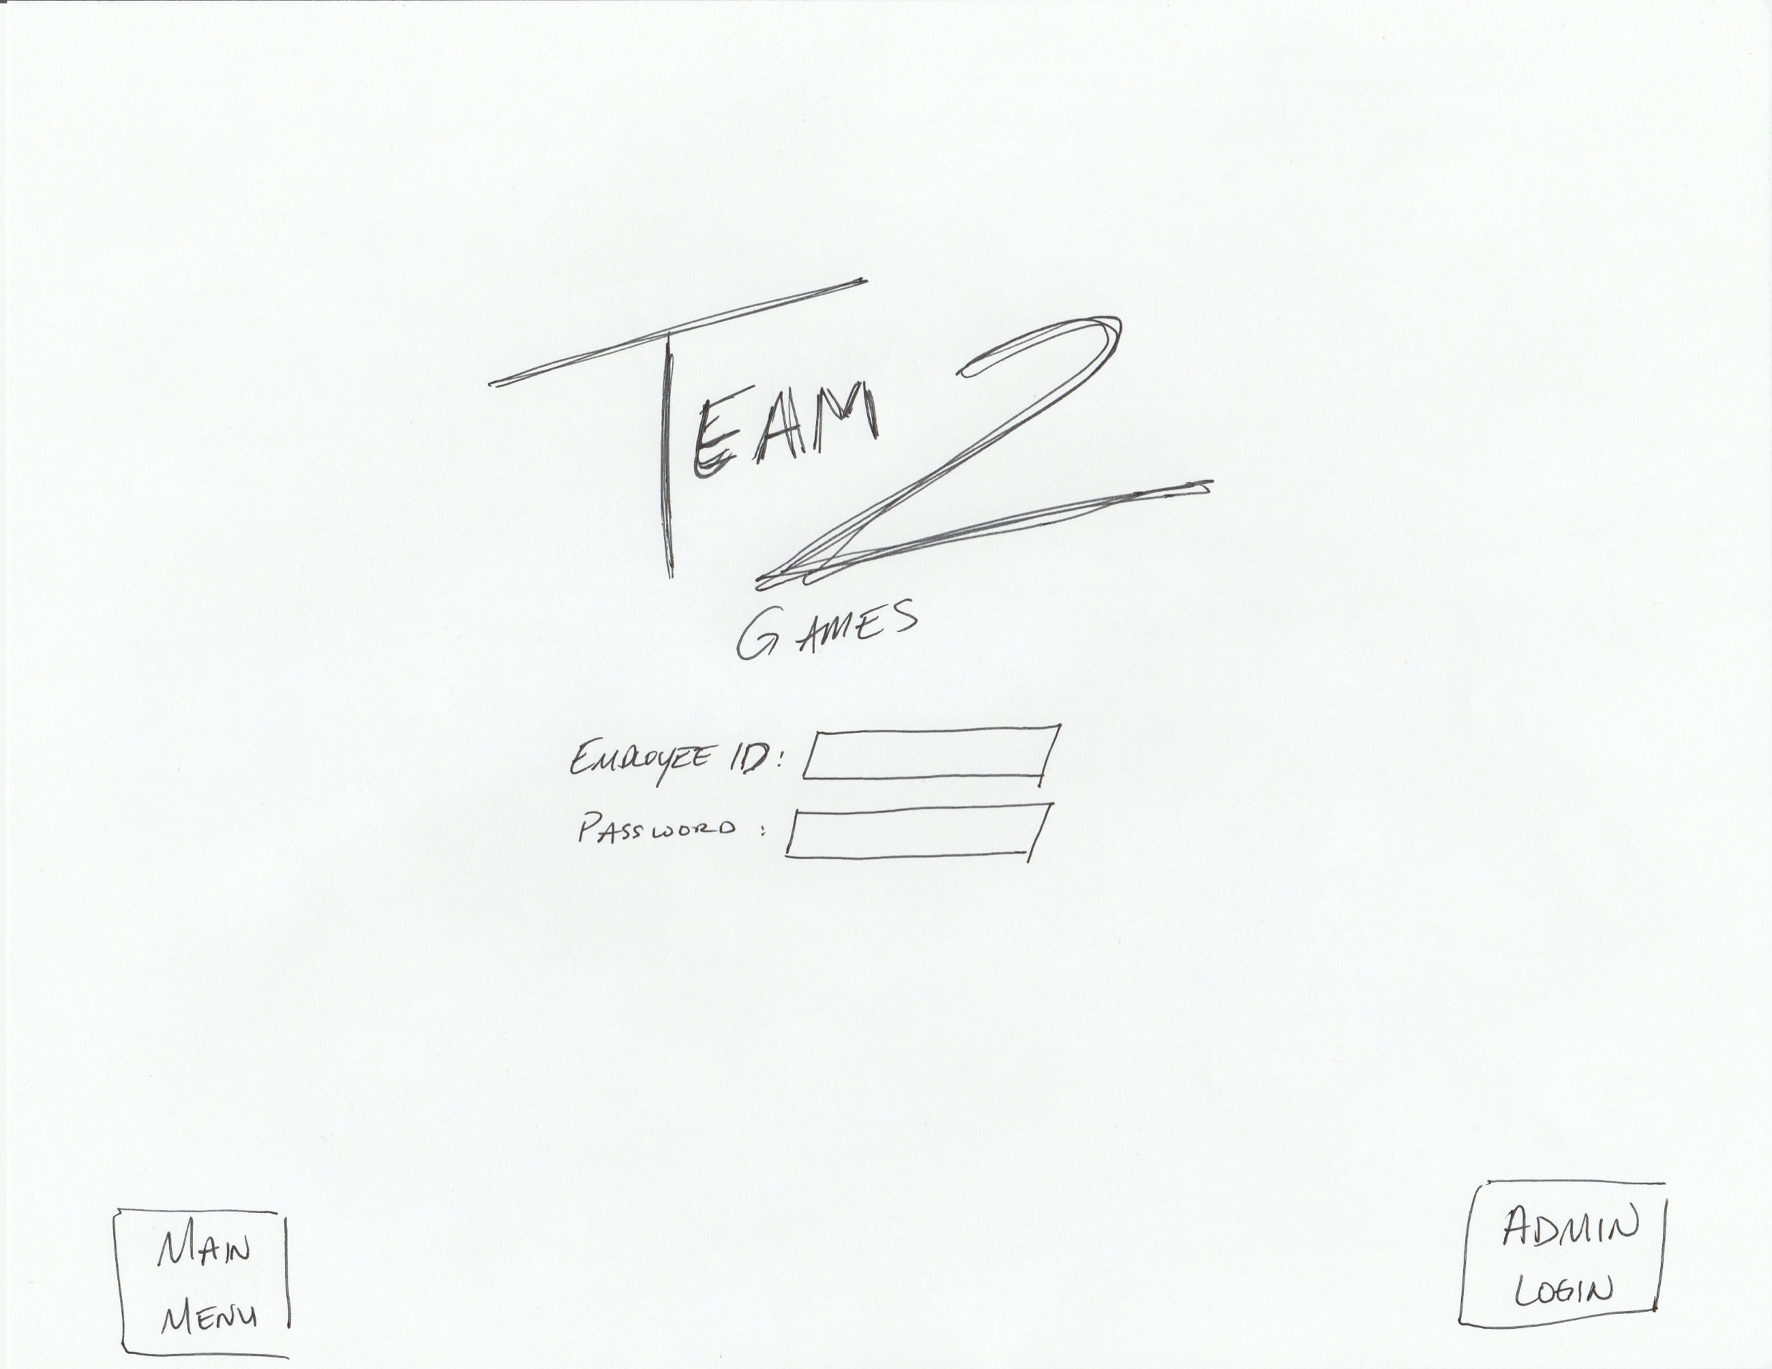
Employee Login Screen
Notes:
Employees can click the “Employee Login” button on the bottom left of the main screen
Employees will input ID and password for access to employee interface

Slide 5
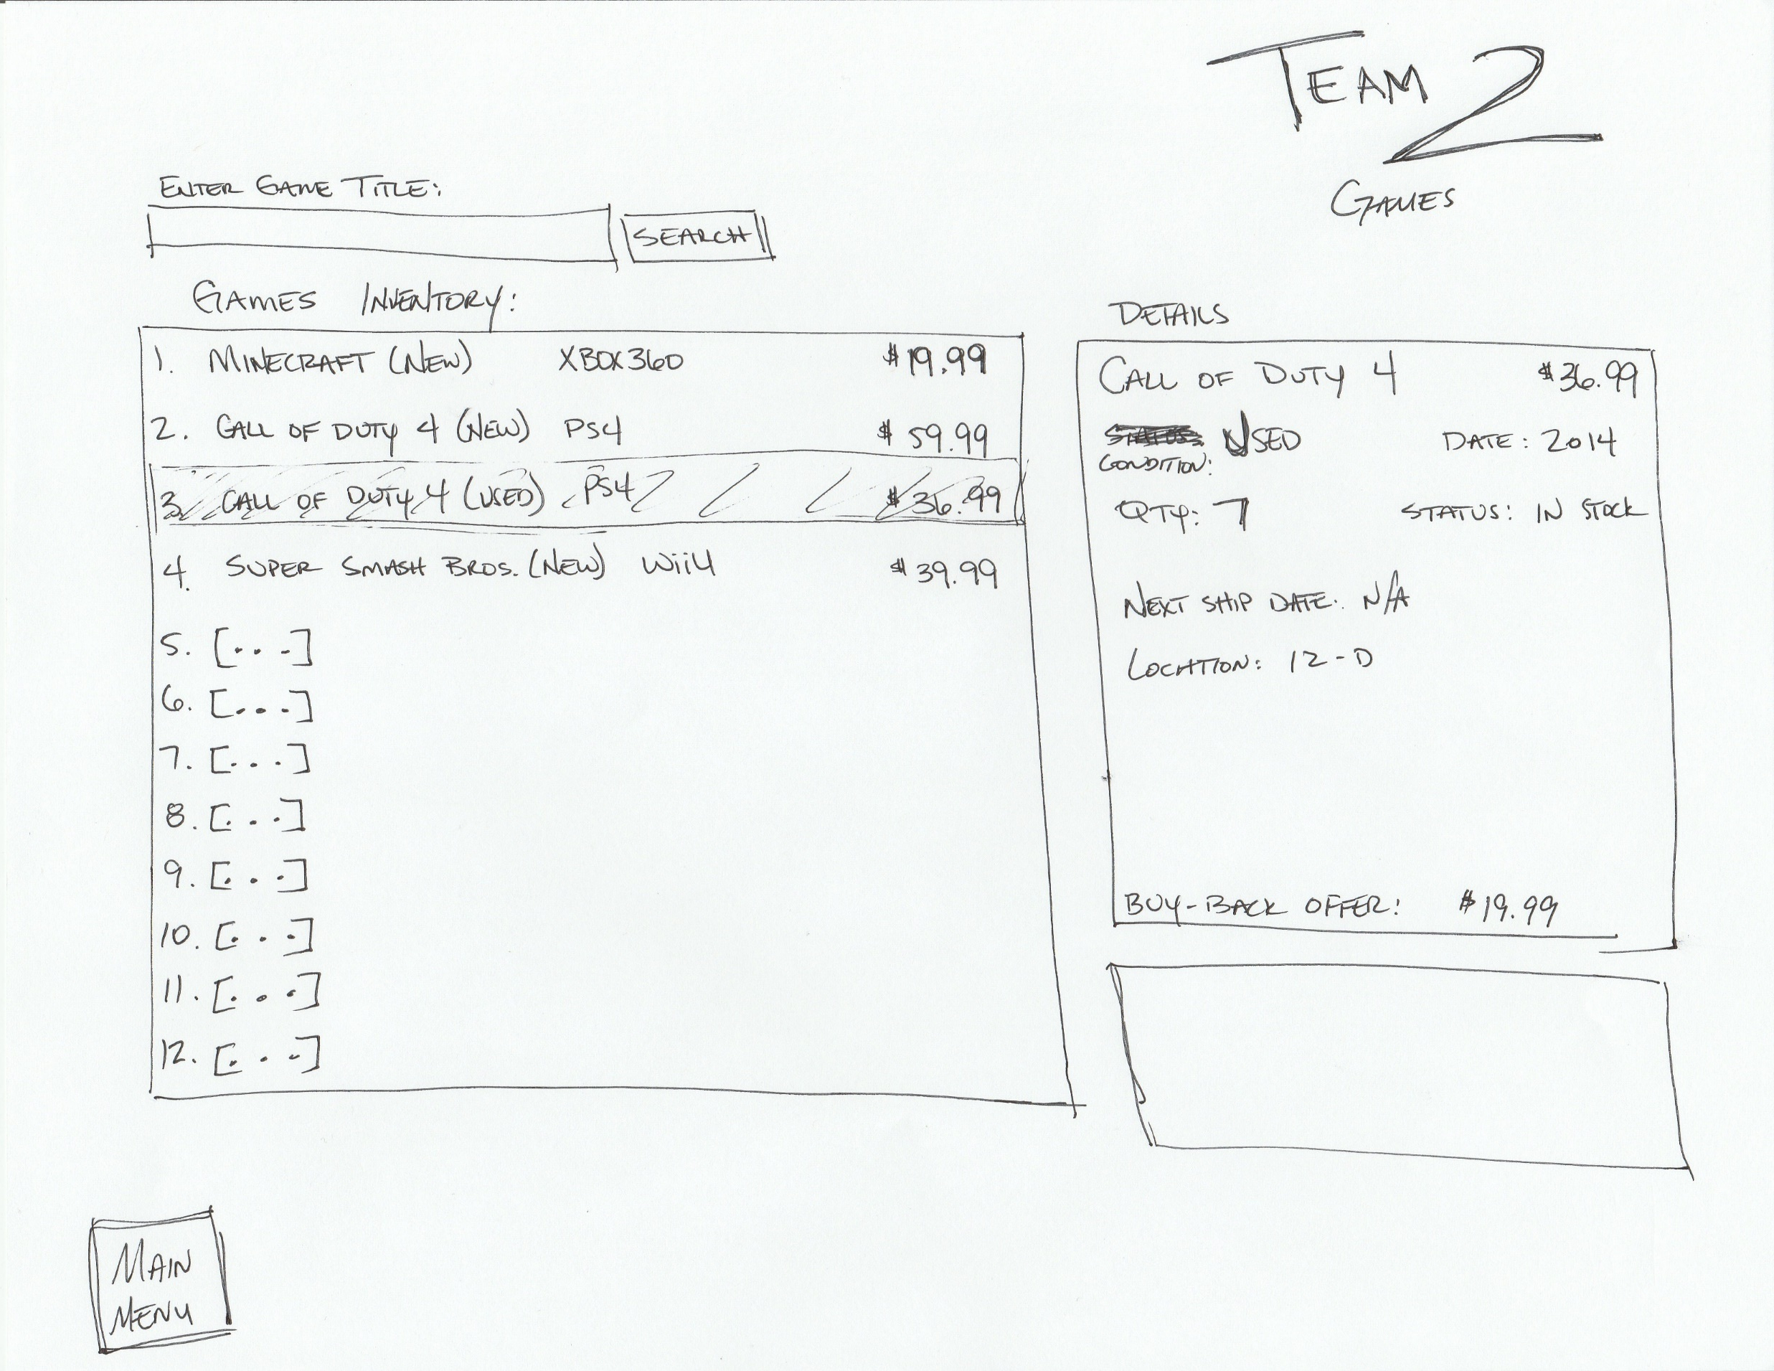
Employee Interface
Notes:
Employees can view more detailed information on this screen
Search function is available, or scrolling through a list of games in the left window
Right window will show more detailed information, including more detailed store info, for the employee

Slide 6
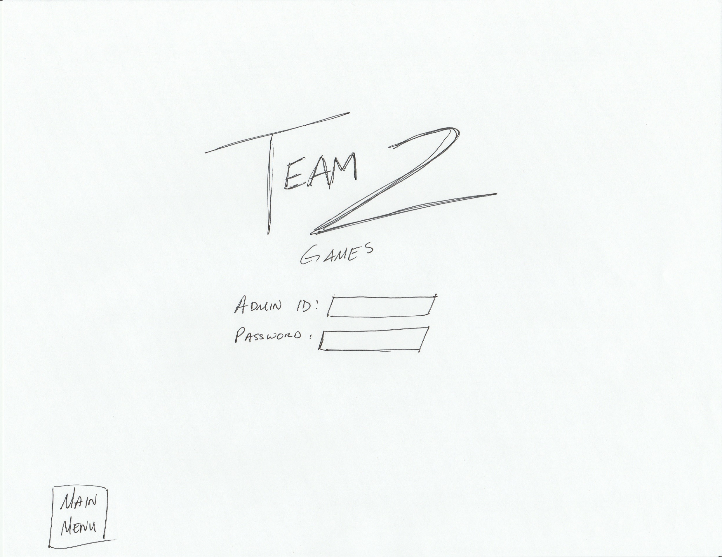
Admin Login
Notes:
Admins can click the “Admin Login” button on the bottom left of the main screen
Admins will input ID and password for access to admin interface

Slide 7
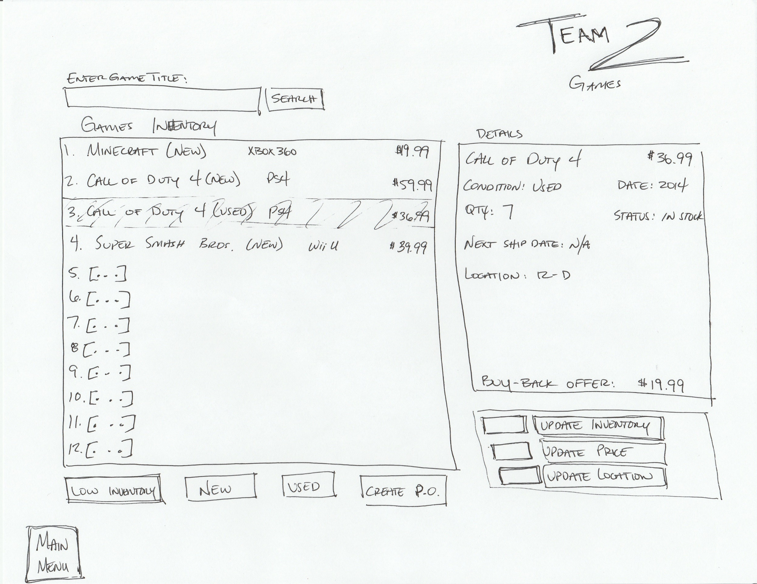
Admin Interface
Notes:
Admins will have control to change the inventory in the store and update pricing, quantity, location, etc.
Button will be available to show games that are below a threshold of inventory to add to purchase orders
Button will be able to filter out new and used games only
Detailed information will be shown in the upper right panel
Admin options will be available in the lower right panel to update information about a specific game

Slide 8
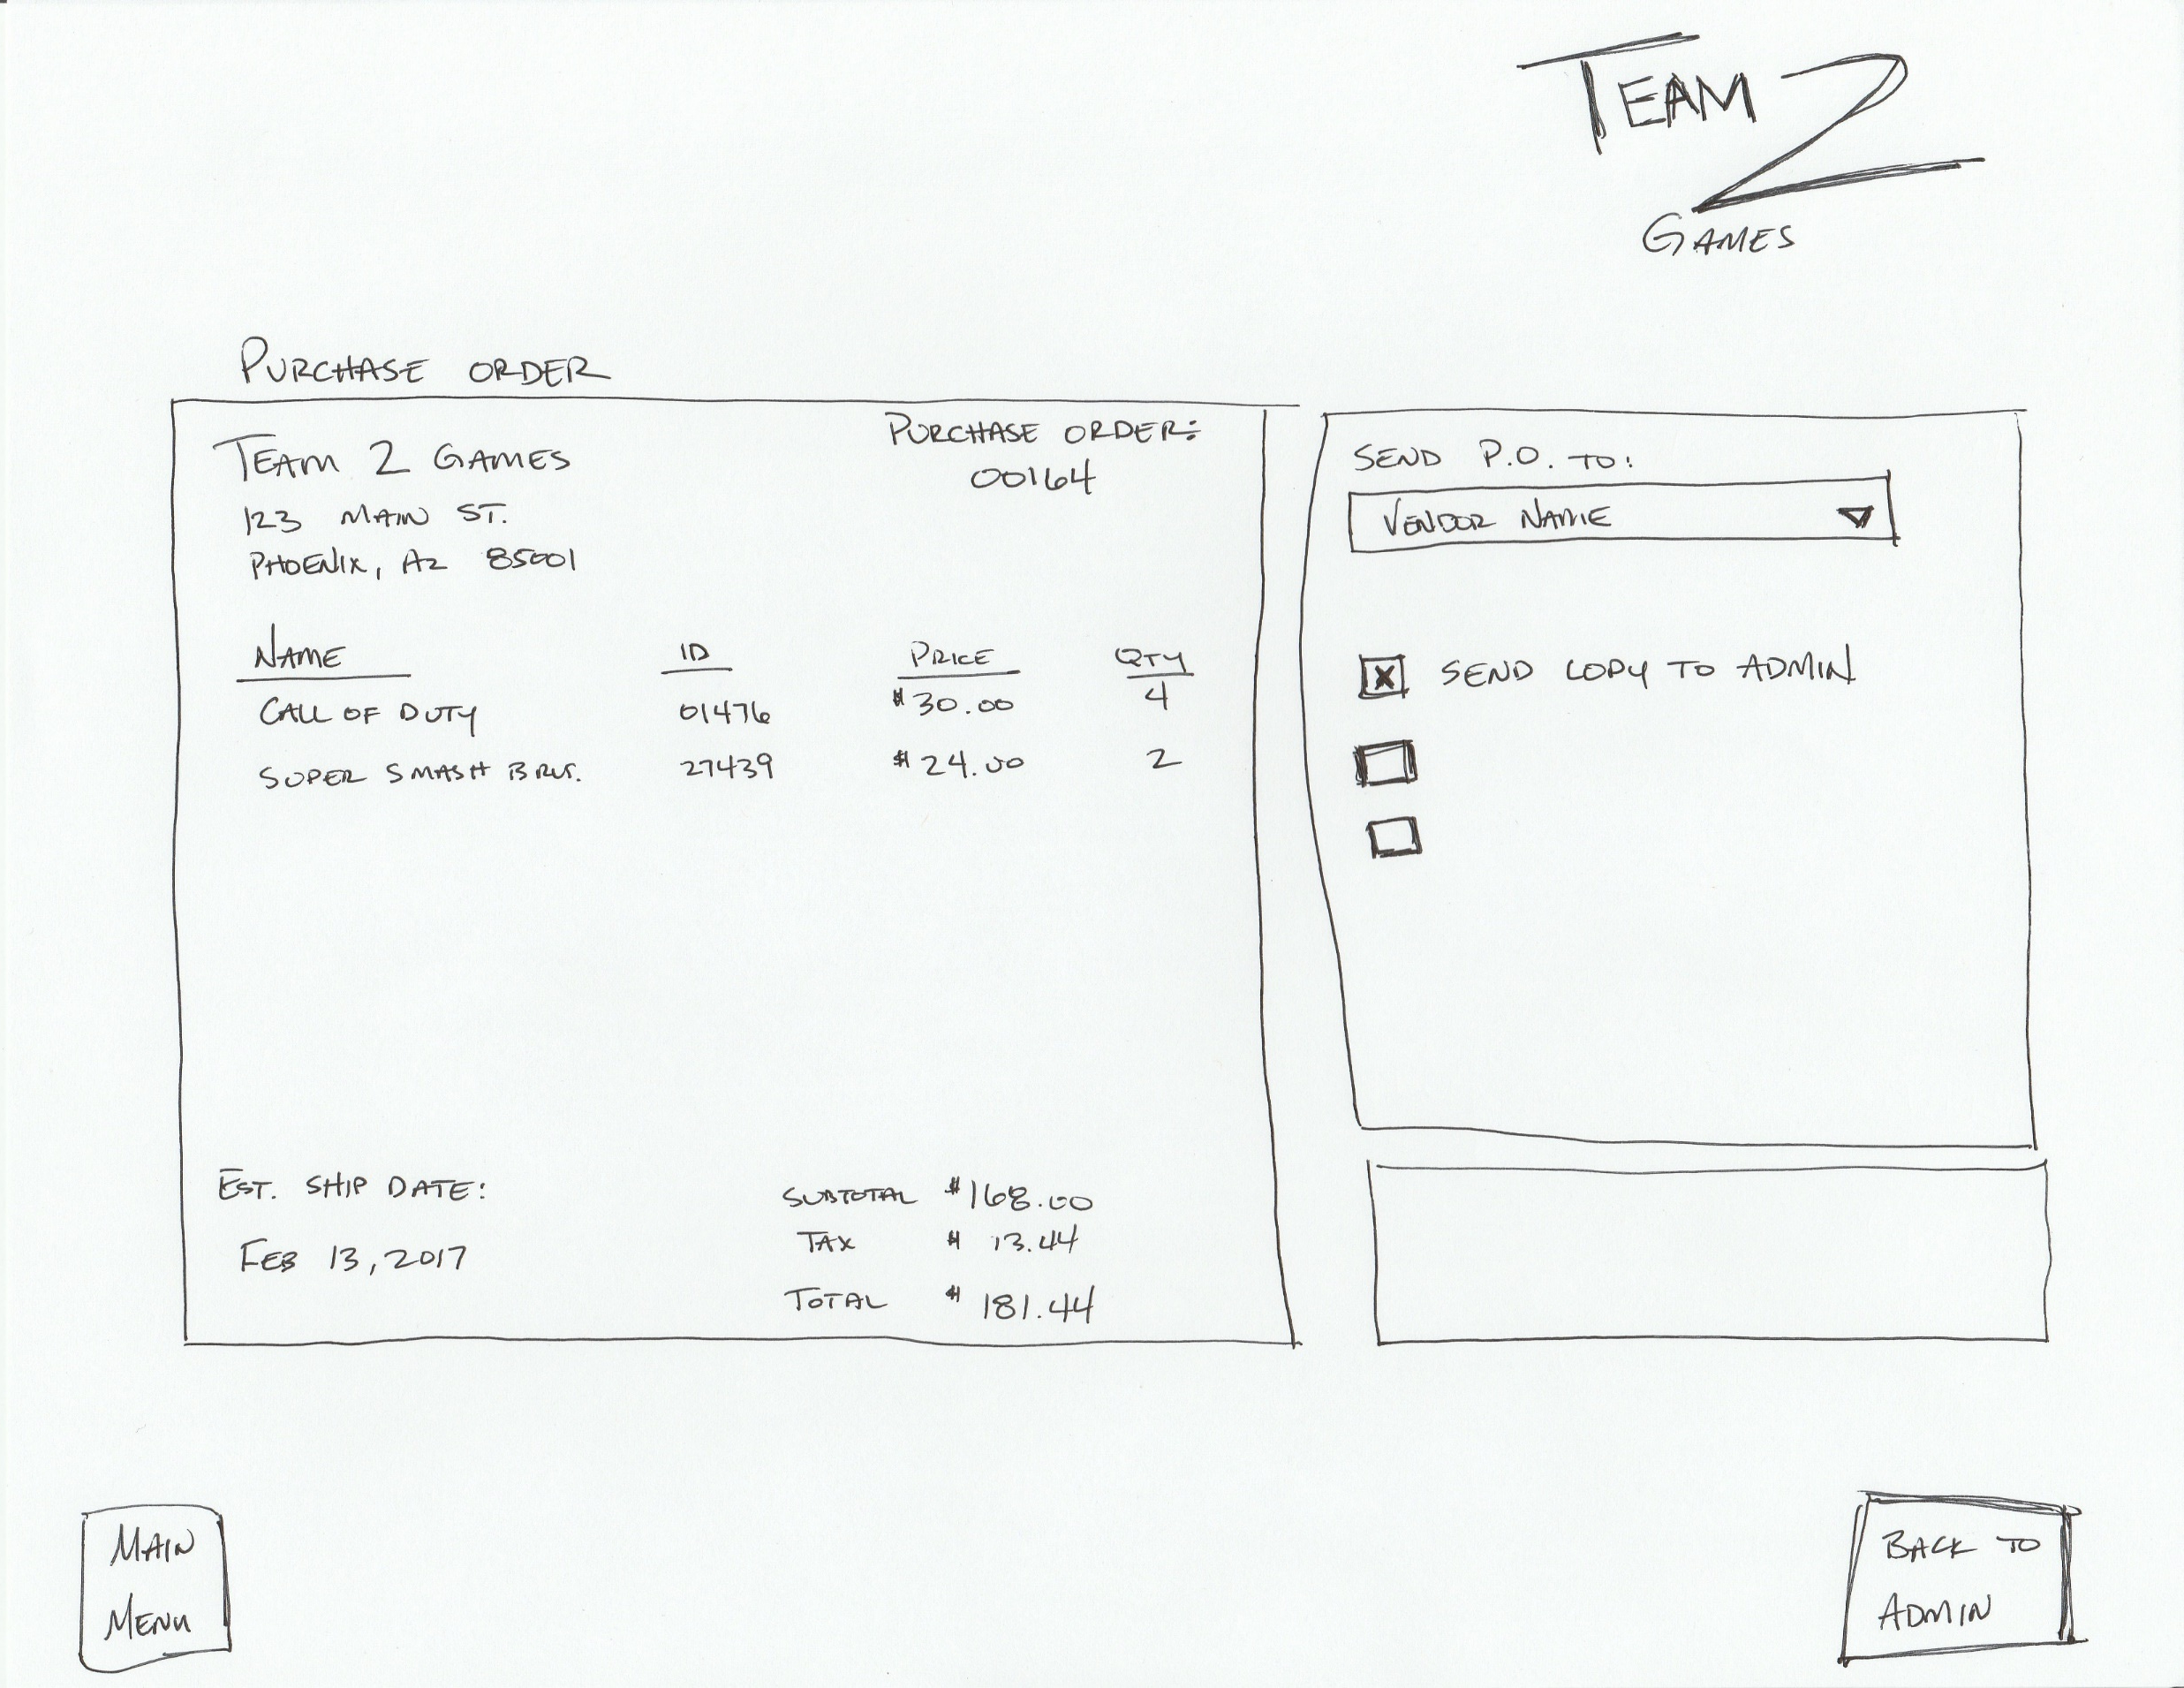
Admin – Purchase Order Screen
Notes:
Purchase order screen can be accessed from the admin interface
This will allow the admin to create a purchase order and select the vendor from a list of vendors for the PO to be sent.
Options below will exist as additional options, based on need of client

